Slide 1
Basics of Web Design
Chapter 2 HTML Basics Key Concepts

Slide 2
Learning Outcomes
Describe the anatomy of a web page
Format the body of a web page with block-level elements including headings, paragraphs, lists, and blockquotes
Configure the text on a web page with inline elements
Configure text with phrase elements
Configure special entity characters, line breaks, and horizontal rules
Configure a web page using new HTML5 header, nav, main, and footer elements
Use the anchor element to link from page to page
Configure absolute, relative, and e-mail hyperlinks
Test a web page for valid HTML syntax

Slide 3
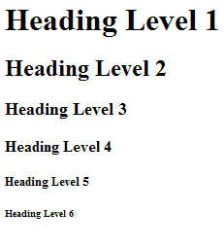
The Heading Element
<h1>Heading Level 1</h1>
<h2>Heading Level 2</h2>
<h3>Heading Level 3</h3>
<h4>Heading Level 4</h4>
<h5>Heading Level 5</h5>
<h6>Heading Level 6</h6>

Slide 4
The Paragraph Element <p> tag
Paragraph element
<p> …paragraph goes here… </p>
Groups sentences and sections of text together.
Configures empty space above and below the paragraph

Slide 5
The Line Break Element <br> tag
Line Break element
Stand-alone tag
Called a void element in HTML5
…text goes here <br> This starts on a new line….
Causes the next element or text to display on a new line
Read Reviews

Slide 6
The Horizontal Rule Element <hr> tag
Horizontal Rule element
void element
<hr >
Configures a horizontal line on the page
In HTML5, it should be used to indicate a thematic break at the paragraph level
Read Reviews

Slide 7
The Blockquote Element <blockquote>
Blockquote element
Indents a block of text for special emphasis
<blockquote>
…text goes here…
</blockquote>

Slide 8
Phrase Elements
Indicate the context and meaning of the text
Display inline with the text
Common Phrase Elements
<b></b>
Text is displayed in bold font
<strong></strong>
Text has strong importance and is displayed in bold
<i></i>
Text is displayed in italic font
<em></em>
Text has emphasis and is displayed in italic font

Slide 9
Phrase Elements
Indicate the context and meaning of the text
Element | Example | Usage
<b> | bold text | Text that has no extra importance but is styled in bold font by usage and convention
<em> | emphasized text | Causes text to be emphasized in relation to other text; usually displayed in italics
<i> | italicized text | Text that has no extra importance but is styled in italics by usage and convention
<mark> | mark text | Text that is highlighted in order to be easily referenced (HTML5 only)
<small> | small text | Legal disclaimers and notices (“fine print”) displayed in small font-size
<strong> | strong text | Strong importance; causes text to stand out from surrounding text; usually displayed in bold
<sub> | _{sub} text | Displays a subscript as small text below the baseline
<sup> | ^{sup} text | Displays a superscript as small text above the baseline

Slide 10
Proper Nesting
CODE:
<p><i>Call for a free quote for your web development needs: <strong>888.555.5555 </strong></i></p>
BROWSER DISPLAY:
Call for a free quote for your web development needs: 888.555.5555

Slide 11
HTML List Basics
Unordered List
Description List (XHTML called it Definition List)
Ordered List

Slide 12
Unordered List
Displays information with bullet points
Unordered List Element
<ul> Contains the unordered list
List Item Element <li> Contains an item in the list

Slide 13
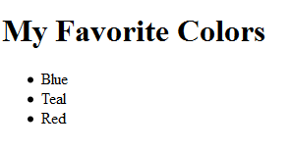
Unordered List Example
<h1>My Favorite Colors</h1>
<ul>
<li>Blue</li>
<li>Teal</li>
<li>Red</li>
</ul>

Slide 14
Ordered List
Conveys information in an ordered fashion
Ordered List Element
<ol> Contains the ordered list
type attribute determines numbering scheme of list
default is numerals
List Item Element <li> Contains an item in the list

Slide 15
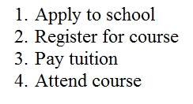
Ordered List Example
<ol>
<li>Apply to school</li>
<li>Register for course</li>
<li>Pay tuition</li>
<li>Attend course</li>
</ol>

Slide 16
Description List
Formerly called a definition list in XHTML and HTML 4.0
Uses:
Display a list of terms and descriptions
Display a list of FAQ and answers
The Description List element <dl> Contains the definition list
The dt Element <dt> Contains a term or name
The dd Element <dd> Contains a definition or description of term Indents the text

Slide 17
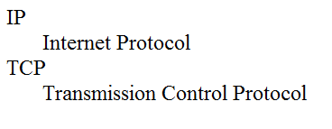
Description List Example
<dl>
<dt>IP</dt>
<dd>Internet Protocol</dd>
<dt>TCP</dt>
<dd>Transmission Control Protocol</dd>
</dl>

Slide 18
Special Entity Characters
Display special characters such as quotes, copyright symbol, etc.
Character Code
© &copy;
< &lt;
> &gt;
& &amp;
&nbsp;

Slide 19
The div element <div>
Purpose:
Configure a specially formatted division or area of a web page
Block display with empty space above and below the div
Can contain other block display and inline display elements

Slide 20
The <div> tag in HTML5 is a versatile container used to group and structure content on a web page. Its primary purposes include:
Grouping Content: The <div> tag is often used to group related elements together, making it easier to apply styles or manipulate the group as a single unit using CSS or JavaScript.
Layout and Structure: It helps in creating the layout of a webpage by dividing it into sections, such as headers, footers, sidebars, and main content areas. This improves the organization and readability of the code.
Styling: By assigning classes or IDs to <div> elements, you can apply specific styles using CSS. This allows for consistent and reusable styling across different parts of the webpage.
JavaScript Manipulation: <div> elements can be targeted and manipulated using JavaScript, enabling dynamic changes to the content or behavior of the webpage.
Semantic Neutrality: Unlike semantic elements like <header>, <footer>, or <article>, the <div> tag does not convey any specific meaning about its content. This makes it a flexible tool for structuring content without implying any particular semantic role.

Slide 21
In this example, the <div> tags are used to create distinct sections of the webpage, which can then be styled or manipulated as needed.
While HTML5 introduced semantic elements for better structure, the <div> tag remains widely used for its flexibility and simplicity.
<div class="header">
<h1>Welcome to My Website</h1>
</div>
<div class="main-content">
<p>This is the main content area.</p>
</div>
<div class="footer">
<p>Copyright © 2023</p>
</div>

Slide 22
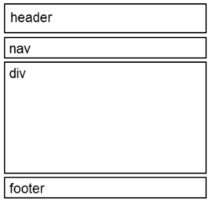
HTML5 Structural Elements
Header Element
<header></header> Contains the headings
Nav Element
<nav></nav> Contains the main navigation
Main Element
<main></main> Contains the main content
Footer Element
<footer></footer> Contains the footer
main

Slide 23
The <nav> tag in HTML5 is a semantic element used to define a section of a webpage that contains navigation links.
Its primary purpose is to provide a clear and meaningful way to mark up navigation menus, making it easier for both developers and assistive technologies (like screen readers) to understand the structure and purpose of the content.
Key Purposes of the <nav> Tag: Semantic Meaning:
The <nav> tag explicitly indicates that the enclosed content is for navigation purposes.
This improves the readability and maintainability of the code.
It helps search engines and assistive technologies identify the navigation section of a webpage.
Accessibility:
Screen readers and other assistive technologies can use the <nav> tag to help users quickly locate and navigate through the main links on a page.
Organization:
It groups related navigation links (e.g., menus, tables of contents, or site maps) into a single block, making the structure of the webpage more organized.
Styling and Scripting:
Like other HTML elements, the <nav> tag can be styled using CSS and manipulated using JavaScript, allowing for custom designs and interactive features.

Slide 24
When to Use the <nav> Tag:
Use the <nav> tag for major navigation blocks, such as:
Main website menus (e.g., links to Home, About, Contact, etc.).
Tables of contents.
Pagination controls.
Sidebar navigation menus.
Note: Avoid using the <nav> tag for minor or incidental links (e.g., a single link in the footer). For such cases, a <div> or <span> is more appropriate.
A webpage can have multiple <nav> elements if there are multiple navigation sections (e.g., a main menu and a footer menu).
The <nav> tag is a semantic element, so it does not inherently apply any visual styling. You need to use CSS to style it.
By using the <nav> tag, you create a more accessible, structured, and meaningful HTML document, which benefits both users and developers.

Slide 25

<nav>
<ul>
<li><a href="/">Home</a></li>
<li><a href="/about">About</a></li>
<li><a href="/services">Services</a></li>
<li><a href="/contact">Contact</a></li>
</ul>
</nav>

Slide 26
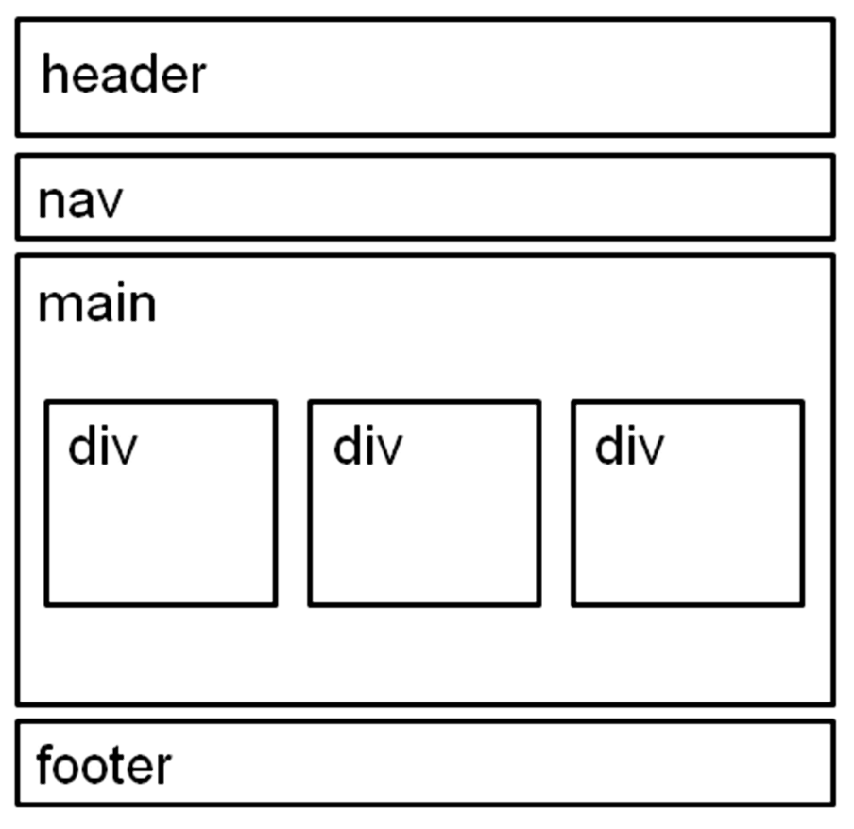
HTML5 Structural Elements
header Element
<header></header> Contains the web page document’s headings
nav Element
<nav></nav> Contains web page document’s main navigation
main Element <main></main> Contains the web page document’s main content
footer Element
<footer></footer> Contains the web page document’s footer

Slide 27
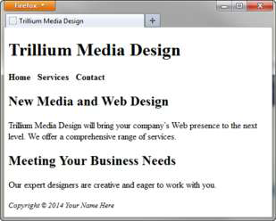
<body>
<header>
<h1>Trillium Media Design</h1>
</header>
<nav>
<b>
<a href="index.html">Home</a> &nbsp;
<a href="services.html">Services</a> &nbsp;
<a href="contact.html">Contact</a>
</b>
</nav>
<main>
<h2>New Media and Web Design</h2>
<p>Trillium Media Design will bring your company&rsquo;s Web presence to the next level. We offer a comprehensive range of services.</p>
<h2>Meeting Your Business Needs</h2>
<p>Our expert designers are creative and eager to work with you.</p>
</main>
<footer>
<small><i>Copyright &copy; 2016 Your Name Here</i></small>
</footer>
</body>

Slide 28
The Anchor Element <a>
The anchor element
Inline display element
Specifies a hyperlink reference (href) to a file
Text between the <a> and </a> is displayed on the web page.
<a href="contact.html">Contact Us</a>
href Attribute
Indicates the file name or URL Web page document, photo, pdf, etc.

Slide 29
More on Hyperlinks
Absolute link
Link to other websites
<a href="http://yahoo.com">Yahoo</a>
Relative link
Link to pages on your own site
Relative to the current page
<a href="index.html">Home</a>

Slide 30
Opening a Link in a New Browser Window
The target attribute on the anchor element opens a link in a new browser window or new browser tab.
<a href="http://yahoo.com" target="_blank">Yahoo!</a>

Slide 31
Email Hyperlinks
Automatically launch the default mail program configured for the browser
If no browser default is configured, a dialog box is displayed
<a href="mailto:me@hotmail.com">me@hotmail.com</a>

Slide 32
Writing Valid HTML
Check your code for syntax errors
Benefit:
Valid code → more consistent browser display
W3C HTML Validation Tool
http://validator.w3.org
Additional HTML5 Validation Tool
http://html5.validator.nu

Slide 33
Summary
This chapter provided an introduction to HTML.
HTML elements used for inline and block display formatting were introduced.
You will use these skills over and over again as you create web pages.

